Slide 1
Potential

Slide 2
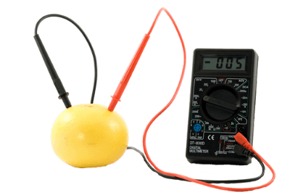
In this Smart Lesson you will learn to:
Define electric current and electrical potential difference.
Recall that the energy available to electric charges moving in an electrical circuit is measured using electrical potential difference.
Explain why electric charge separation produces an electrical potential difference.
Solve problems involving electrical potential difference.

Slide 3

An electrical circuit is a conductive loop which through which a charge flows.
The charge is generated by some energy source, and the energy is used by various circuit components called loads (or sinks).
The energy is electrical energy, and loads convert it into some other kind of energy.

Slide 4

Converting energy.
To the left is an example of a basic circuit: a battery connected to a lamp and a switch. The battery is an energy source which provides energy in the form of current to the lamp (a load). The lamp converts this energy into heat and light energy.

Slide 5
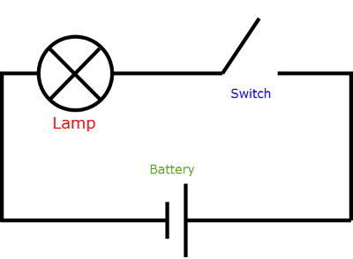

The simple circuit can be drawn symbolically as below:
This is a circuit diagram, which provides a simple way to describe potentially complicated circuits. Note the battery symbol - positive terminal is the larger line.
In the circuit diagram the switch is open. It could be drawn closed as

Slide 6
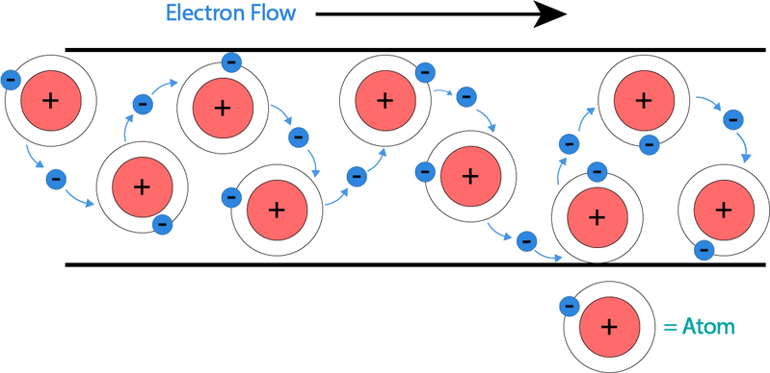
So what is electric current?
Electric current is defined as the rate of movement of electric charge carriers from one part of a conductor to another.
Electric charge carriers are usually electrons or ions.
So current is the flow of charge carriers, such as electrons.
The unit of current is Amperes (A) and electrical current is represented as (I) in formulae.
For example V=I×R, where V is voltage, I is current and R is resistance.

Slide 7
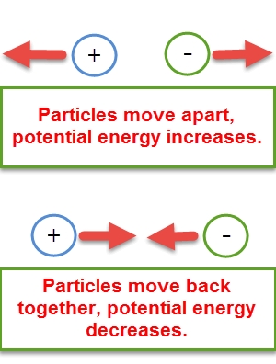
Energy is needed to separate opposite charges.
A positive and negative charge attract each other strongly if they are close together, but can be separated if they are provided with energy.
This energy is stored in the charges as potential energy, which is ready to be transferred or transformed. If the charges are allowed to move back together then they lose potential energy, and it takes work to separate them again.
In a similar fashion, two like charges will repel each other more the closer they are together. It takes work to move the charges together, and this is stored as potential energy.

Slide 8
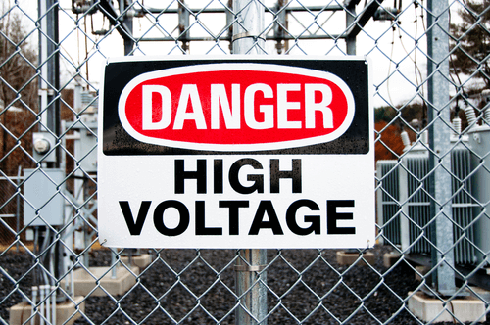
So what is meant by potential difference?
Electrical potential difference is defined as the change in potential energy per unit charge between two defined points in a circuit.
The unit of electrical potential difference is volts (V); sometimes referred to as the voltage.

Slide 9
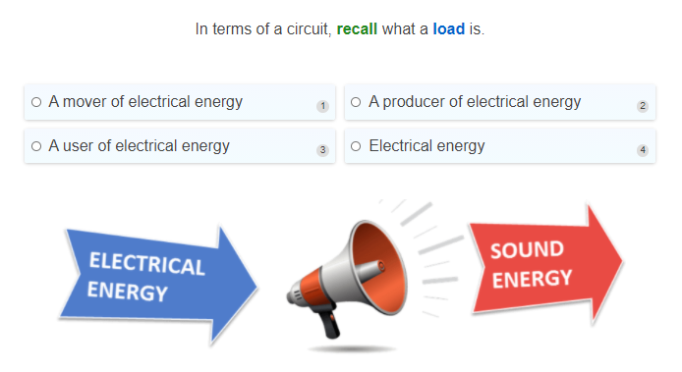

Slide 10
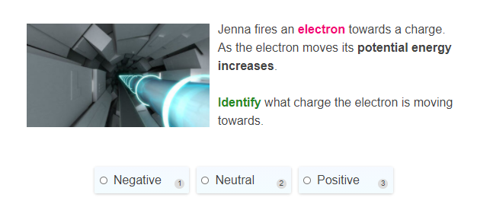

Slide 11
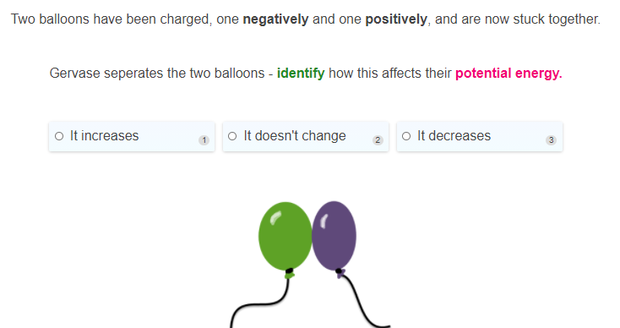

Slide 12
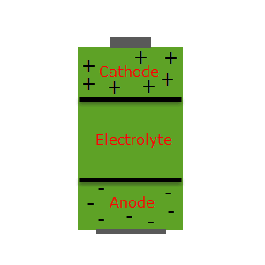
Batteries.
A battery is a source of potential energy per charge, or emf (electromotive force). In a charged battery, a chemical reaction separates positive and negative charges to each terminal of the battery.
This clusters a lot of like charges near each other, giving them very high potential energy. Circuits connect the positive and negative terminals with wires, and the electron build-up in the negative terminal creates a current towards the positive terminal.

Slide 13
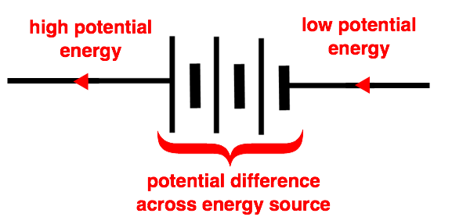
The battery keeps current flowing, providing the wire with more electrons.
Placing a load such as a lamp in the circuit will light it as the potential energy of the electrons is converted into heat and light energy.
Electrons near the positive terminal have a low potential energy.
Electrons near the negative terminal have a high potential energy.
This creates a potential difference.

Slide 14


Slide 15
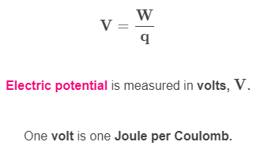
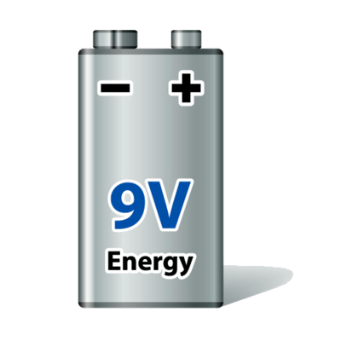
Potential difference calculations.
Electric potential, with symbol V, is the electric potential energy (W, units Joules(J)) per unit charge (q, units Coulombs(C)) at a particular point. We write this as:

Slide 16
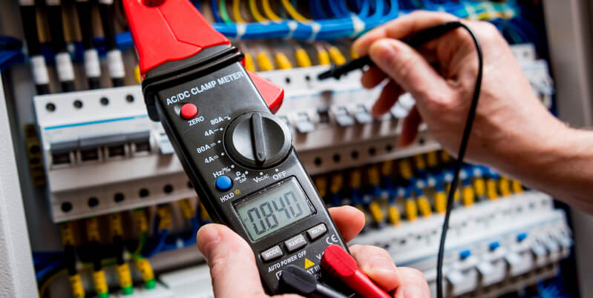
We measure potential at a point relative to a reference point, so often we are measuring not the potential but the potential difference.
This is the difference in potential energy per unit charge between two points. Potential difference has the same symbol, V, and is referred to as "Voltage".
When a charge q moves between points it will have a change in potential energy. This gain/loss is equal to W=qV.
We measure potential difference with a voltmeter by connecting it to two different parts of a circuit, and it gives us the potential difference between those two parts.

Slide 17
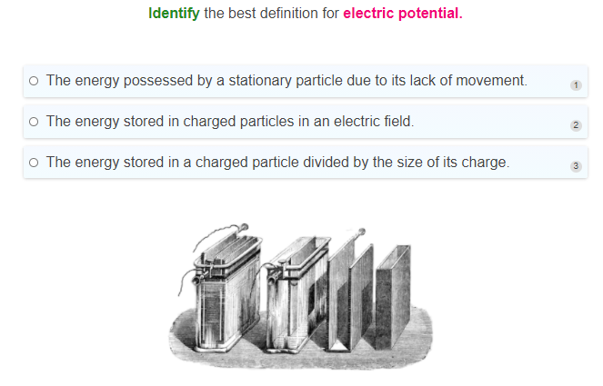

Slide 18
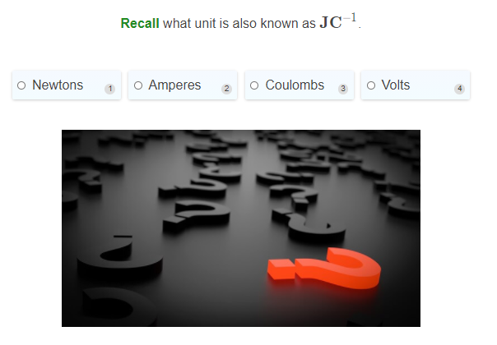

Slide 19
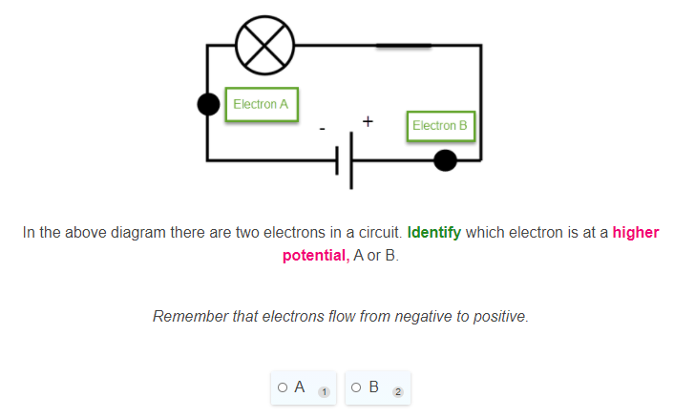

Slide 20
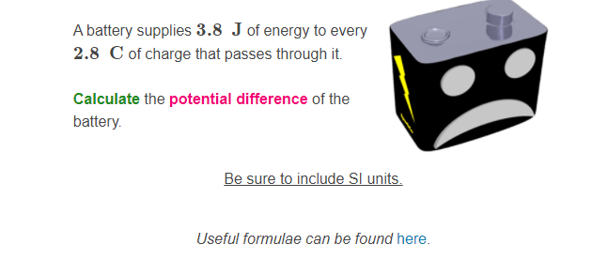

Slide 21
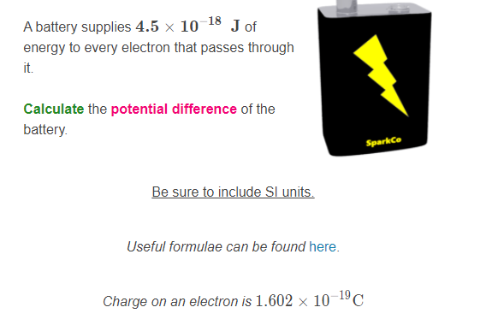

Slide 22
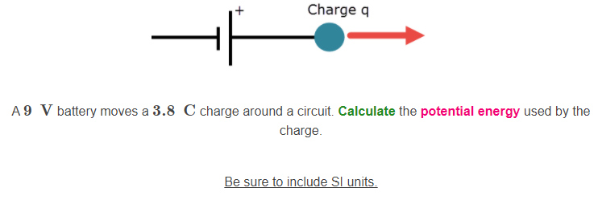

Slide 23
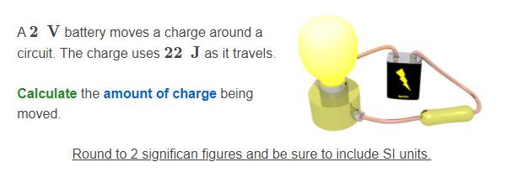

Slide 24
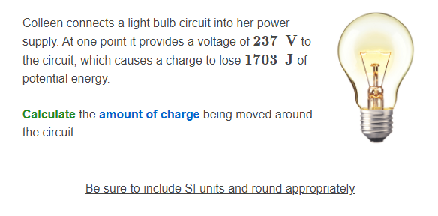

Slide 25
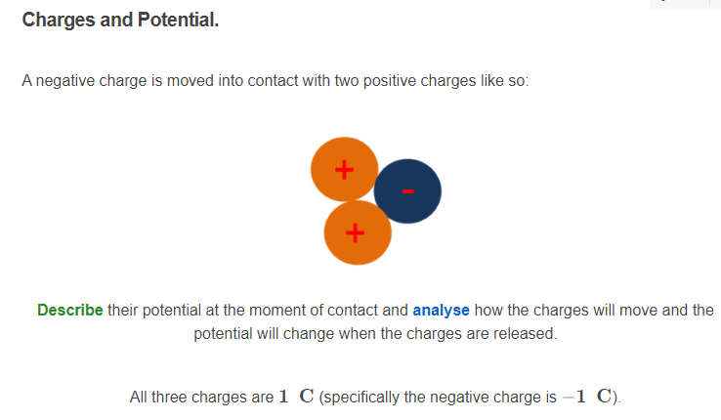

Slide 26
